Slide 1
ECONOMICS AS A SUBJECT OF SCIENCE
First lecture

Slide 2
Why Should I Study Economics?
Economics is the science of greed (F.V. Myer)
Notes:
Economists develop theories of the behavior of individuals (consumers, workers) and institutions (businesses, governments) engaged in the production, exchange, and consumption of goods and services. Theories, principles, and models are “purposeful simplifications.” The full scope of economic reality itself is too complex and bewildering to be understood as a whole. In developing theories, principles, and models economists remove the clutter and simplify. Economic principles and models are highly useful in analyzing economic behavior and understanding how the economy operates. They are the tools for ascertaining cause and effect (or action and outcome) within the economic system. Good theories do a good job of explaining and predicting. They are supported by facts concerning how individuals and institutions actually behave in producing, exchanging, and consuming goods and services.

Slide 3
Objectives
To determine economics definition
To understand the importance of economics science and its development roots from early ages
To understand difference between microeconomics and macroeconomics
To define main economic resources

Slide 4
Definition of Economics (1)
The very word “economics” takes its name from Xenophon’s instructional treatise on efficient management and leadership, the “Oeconomicus”
Economics is a social science because it studies human behaviour rather than the disembodied workings of nature.
Economics may be taken to include the study of the general principles of administration of resources, whether of an individual, a household, or business or State.

Slide 5
Definition of Economics (2)
Economics is the efficient allocation of the scarce means of production toward the satisfaction of human needs.
Scarce means of production are our resources, which we use to produce all the goods and service we buy.
Because they provide satisfaction for us!

Slide 6
History of Economics
Main schools (or concepts) of economic history are:
the prehistory of economic thought (the economic thought of Ancient China, Ancient India, Ancient Egypt, Ancient Mesopotamia and Persians);
Ancient Greek and Medieval economic thought;
Mercantilism and physiocrats;
Classical and neoclassical (marginalism) schools;
Marxism and social utopism;
Keynesim and neo-keynesim, post-keynesim;
Liberalism and neoliberals;
Monetarism

Slide 7
Principles of Economics (1)
Observing real-world behavior and outcomes.
Based on those observations, formulating a possible explanation of cause and effect (hypothesis).
Testing this explanation by comparing the outcomes of specific events to the outcome predicted by the hypothesis.
Accepting, rejecting, and modifying the hypothesis, based on these comparisons.
Continuing to test the hypothesis against the facts. As favorable results accumulate, the hypothesis evolves into a theory.
Notes:
Like the physical and life sciences, as well as other social sciences, economics relies on the scientific method.

Slide 8
Principles of Economics (2)
A very well-tested and widely accepted theory is referred to as an economic law or an economic principle—a statement about economic behavior or the economy that enables prediction of the probable effects of certain actions.
Notes:
Combinations of such laws or principles are incorporated into models, which are simplified representations of how something works, such as a market or segment of the economy.

Slide 9
Principles of Economics (3)
Generalizations. Economic principles are generalizations relating to economic behavior or to the economy itself. Economic principles are expressed as the tendencies of typical or average consumers, workers, or business firms.

Slide 10
Principles of Economics (4)
Other-Things-Equal Assumption. In constructing their theories, economists use the ceteris paribus or other-things-equal assumption—the assumption that factors other than those being considered do not change.
Graphical Expression. Many economic models are expressed graphically.

Slide 11
Economic Perspective Elements
Scarcity and choice, purposeful behavior, and marginal analysis. It sees individuals and institutions making rational decisions based on comparisons of marginal costs and marginal benefits.

Slide 12
Scarcity and Choice
Scarce economic resources mean limited goods and services.
Scarcity restricts options and demands choices.

Slide 13
Purposeful Behaviour
Economics assumes that human behavior reflects “rational self-interest.”
Individuals look for and pursue opportunities to increase their utility— the pleasure, happiness, or satisfaction obtained from consuming a good or service.

Slide 14
Marginal Analysis: Benefits and Costs
The economic perspective focuses largely on marginal analysis—comparisons of marginal benefits and marginal costs, usually for decision making.
To economists, “marginal” means “extra,” “additional,” or “a change in.”
Most choices or decisions involve changes in the status quo, meaning the existing state of affairs.

Slide 15
Microeconomics
Microeconomics is the part of economics concerned with decision making by individual customers, workers, households, and business firms.
We measure:
the price of a specific product,
the number of workers employed by a single firm,
the revenue or income of a particular firm or household,
the expenditures of a specific firm, government entity, or
family.
Notes:
At this level of analysis, we observe the details of their behavior under a figurative microscope.

Slide 16
Macroeconomics (1)
Macroeconomics examines either the economy as a whole or its basic subdivisions or aggregates, such as the government, household, and business sectors.
An aggregate is a collection of specific economic units treated as if they were one unit. Therefore, we might lump together the millions of consumers in the EU economy and treat them as if they were one huge unit called “consumers.”

Slide 17
Macroeconomics (2)
Macroeconomics seeks to obtain an overview, or general outline, of the structure of the economy and the relationships of its major aggregates.
Macroeconomics speaks of such economic measures as total output, total employment, total income, aggregate expenditures, and the general level of prices in analyzing various economic problems. No or very little attention is given to specific units making up the various aggregates.
Notes:
The micro–macro distinction does not mean that economics is so highly compartmentalized that every topic can be readily labeled as either micro or macro; many topics and subdivisions of economics are rooted in both.
Example: While the problem of unemployment is usually treated as a macroeconomic topic (because unemployment relates to aggregate production), economists recognize
that the decisions made by individual workers on how long to search for jobs and the way s pecific labor markets encourage or impede hiring are also critical in determining the unemployment rate.

Slide 18
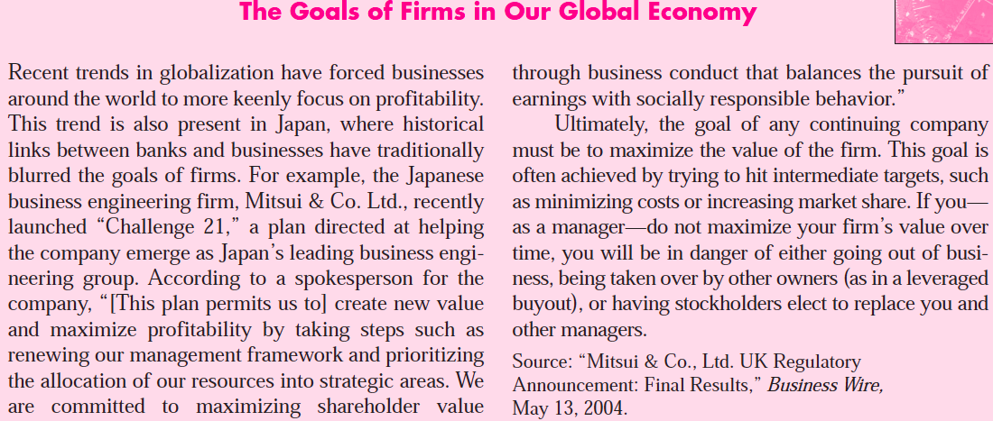

Slide 19
The Four Economic Resources: Land
Land means much more to the economist than it does to most people. To the economist land includes all natural resources (“gifts of nature”) used in the production process, such as arable land, forests, mineral and oil deposits, and water resources.

Slide 20
The Four Economic Resources: Labour
The resource labour consists of the physical and
mental talents of individuals used in producing goods and services. The services of a logger, retail clerk, machinist, teacher, professional football player, and nuclear physicist all fall under the general heading “labour.”

Slide 21
The Four Economic Resources: Capital
For economists, capital (or capital goods) includes all manufactured aids used in producing consumer goods and services. Included are all factory, storage, transportation, and distribution facilities, as well as tools and machinery. Economists refer to the purchase of capital goods as investment.
Notes:
Capital goods differ from consumer goods because consumer goods satisfy wants directly, whereas capital goods do so indirectly by aiding the production of consumer goods. Note that the term “capital” as used by economists refers not to money but to tools, machinery, and other productive equipment. Because money produces nothing, economists do not include it as an economic resource. Money (or money capital or financial capital) is simply a means for purchasing capital goods.

Slide 22
The Four Economic Resources: Entrepreneurial Ability (1)
The entrepreneur performs several functions:
The entrepreneur takes the initiative in combining the resources of land, labor, and capital to produce a good or a service. Both a sparkplug and a catalyst, the entrepreneur is the driving force behind production and the agent who combines the other resources in what is hoped will be a successful business venture.

Slide 23
The Four Economic Resources: Entrepreneurial Ability (2)
The entrepreneur makes the strategic business decisions that set the course of an enterprise.
The entrepreneur is an innovator. He or she commercializes new products, new production techniques, or even new forms of business organization.
The entrepreneur is a risk bearer. The entrepreneur has no guarantee of profit.
Notes:
The reward for the entrepreneur’s time, efforts, and abilities may be profits or losses. The entrepreneur risks not only his or her invested funds but those of associates and
stockholders as well. Because land, labor, capital, and entrepreneurial ability are combined to produce goods and services, they are called the factors of production, or simply “inputs.”

Slide 24
Production Possibilities Model
To keep things simple, let’s initially assume:
Full employment The economy is employing all its available resources.
Fixed resources The quantity and quality of the factors of production are fixed.
Fixed technology The state of technology (the methods used to produce output) is constant.
Two goods. The economy is producing only two goods.

Slide 25
Production Possibilities Model
The optimal (best) point on the production possibilities curve represents the most desirable mix of goods and is determined by expanding the production of each good until its marginal benefit (MB) equals its marginal cost (MC).

Slide 26
Opportunity Cost
The opportunity cost of any choice is the forgone value of the next best alternative.
The economic rationale for the law of increasing opportunity costs is that economic resources are not completely adaptable to alternative uses. Many resources are better at producing one type of good than at producing others.

Slide 27
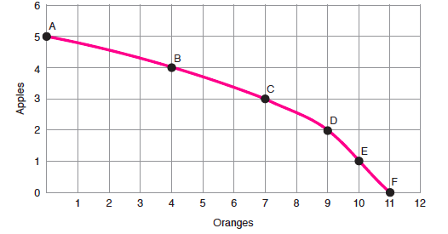
Finding the Opportunity Cost
Notes:
We are giving up 2 oranges. Now, let’s take it up a notch. What is the opportunity cost of moving from A to D? It’s 3 apples, because at point A we produced 5 apples, but at point D we’re producing only 2. One more
question: What is the opportunity cost of moving from E to B? It’s 6 oranges, because at E we produced 10 oranges and at B, only 4. What if we were at the origin? What would that represent? Think about it. What would be the production of guns? How about the production of butter? They would both be zero. Is that possible? During the Great Depression in the 1930s, the U.S. economy
sank to point Z, but no economy has ever sunk to the origin

Slide 28
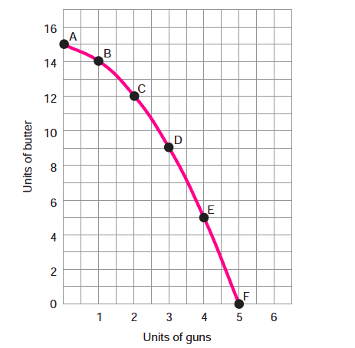
The Production Possibilities Curve
Notes:
This curve shows the range of possible combinations of outputs of guns and butter extending from 15 units of butter and no guns at point A to 5 units of guns and no butter at point F.

Slide 29
The Production Possibilities Curve
The production possibilities curve represents a two-product economy at full employment

Slide 30
Full Employment and Full Production
Full employment . The economy is employing all its available resources.
Fixed resources. The quantity and quality of the factors of production are fixed.
Fixed technology. The state of technology (the methods used to produce output) is constant.

Slide 31
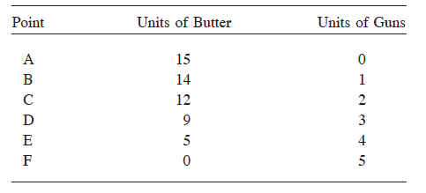
The Production Possibilities Curve

Slide 32
Productive Efficiency
Productive efficiency is attained when the maximum possible output of any one good is produced, given the output of other goods.

Slide 33
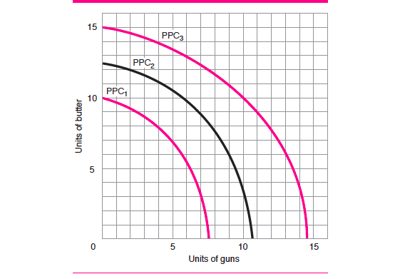
Economic Growth
Notes:
Production Possibilities Curves A move from PPC 1 to PPC 2 and from PPC 2 to PPC 3 represents economic growth.

Slide 34
Economic Growth
When we drop the assumptions that the quantity and quality of resources and technology are fixed, the production possibilities curve shifts positions and the potential maximum output of the economy changes.

Slide 35
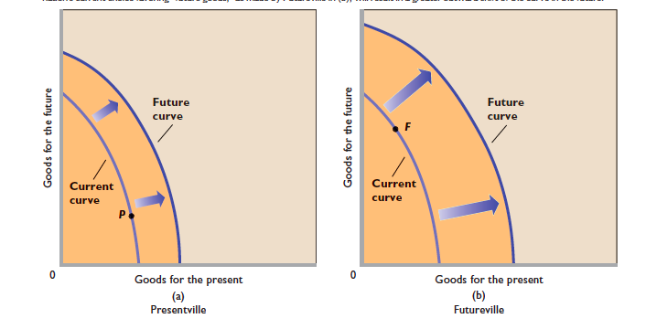
Present choices and future locations of production possibilities curves

Slide 36
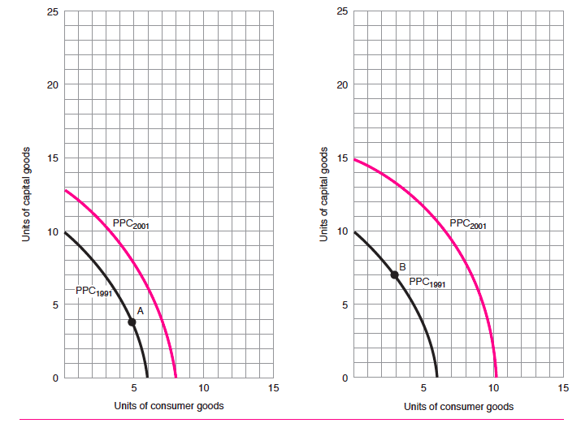
Current Issue: Will You Be Underemployed When You Graduate?
Notes:
I happened to graduate during a bad year. My only job offer was from the recruiter from Continental Baking Company to drive a bakery truck. “But how will I use my economics?” He told me I could economize on the gasoline. Had I taken the truck-driving job, I would have been underemployed. When you graduate, you may face the same problem. It turns out that one in fi ve college graduates ends up in a job that does not require a college degree. In addition, many employers require a degree just as a credential. So when you start interviewing, ask yourself, “I need a degree to do this ? ” There are millions of college grads who are asking themselves this very question. Some 37 percent of all flight attendants hold bachelor’s degrees, as do 19 percent of the theater ushers, lobby attendants, and ticket takers. In addition, 13 percent of all bank tellers
and 14 percent of all typists and word processors are college graduates. 6 From time to time you’ll hear reports of PhD’s driving cabs, lawyers typing their own briefs, and doctors bogged down in paperwork. Perhaps there’s some degree of under-employment in almost everyone’s future.

Slide 37
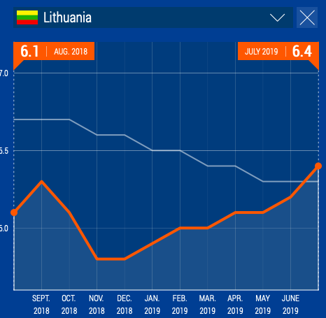
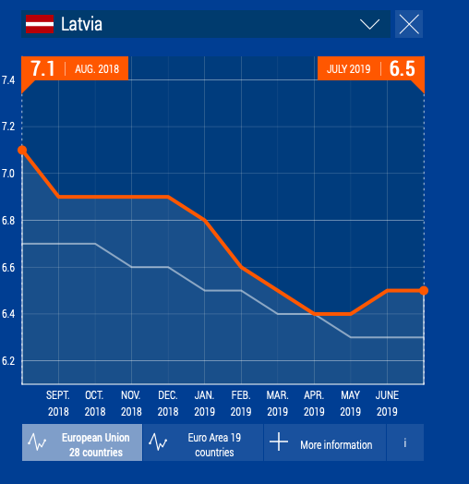
Comparison of main indicators EU vs Lithuania: unemployment rate

Slide 38
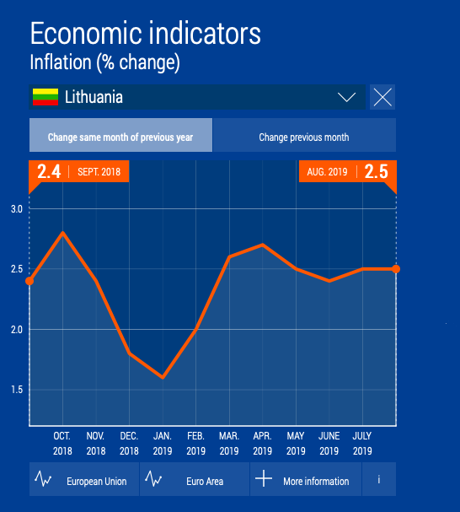
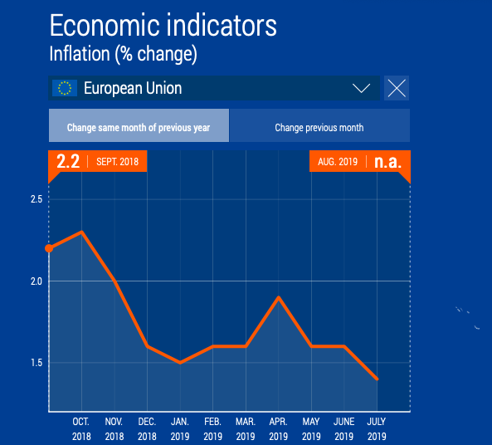
Comparison of main indicators EU vs Lithuania: inflation

Slide 39
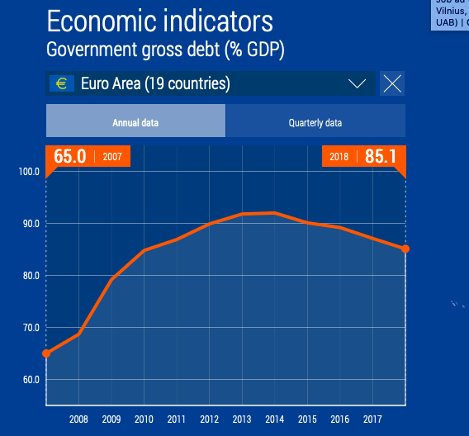
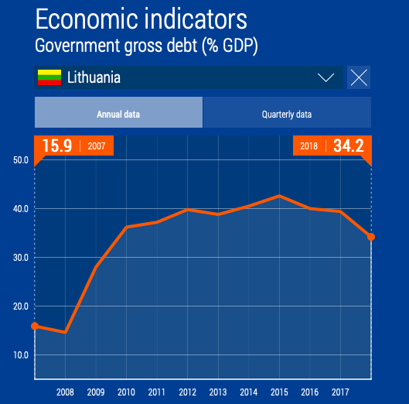
Comparison of main indicators EU vs Lithuania: government debt

Slide 40
THANK YOU!

